Slide 1
The Modern Salesforce Development Workflow with Visual Studio Code
Notes:
0 minutes

Slide 2
Safe Harbor
Safe harbor statement under the Private Securities Litigation Reform Act of 1995:
This presentation may contain forward-looking statements that involve risks, uncertainties, and assumptions. If any such uncertainties materialize or if any of the assumptions proves incorrect, the results of salesforce.com, inc. could differ materially from the results expressed or implied by the forward-looking statements we make. All statements other than statements of historical fact could be deemed forward-looking, including any projections of product or service availability, subscriber growth, earnings, revenues, or other financial items and any statements regarding strategies or plans of management for future operations, statements of belief, any statements concerning new, planned, or upgraded services or technology developments and customer contracts or use of our services.
The risks and uncertainties referred to above include – but are not limited to – risks associated with developing and delivering new functionality for our service, new products and services, our new business model, our past operating losses, possible fluctuations in our operating results and rate of growth, interruptions or delays in our Web hosting, breach of our security measures, the outcome of any litigation, risks associated with completed and any possible mergers and acquisitions, the immature market in which we operate, our relatively limited operating history, our ability to expand, retain, and motivate our employees and manage our growth, new releases of our service and successful customer deployment, our limited history reselling non-salesforce.com products, and utilization and selling to larger enterprise customers. Further information on potential factors that could affect the financial results of salesforce.com, inc. is included in our annual report on Form 10-K for the most recent fiscal year and in our quarterly report on Form 10-Q for the most recent fiscal quarter. These documents and others containing important disclosures are available on the SEC Filings section of the Investor Information section of our Web site.
Any unreleased services or features referenced in this or other presentations, press releases or public statements are not currently available and may not be delivered on time or at all. Customers who purchase our services should make the purchase decisions based upon features that are currently available. Salesforce.com, inc. assumes no obligation and does not intend to update these forward-looking statements.
Notes:
15 seconds

Slide 3
Welcome to The Modern Salesforce Development Workflow with Visual Studio Code
Notes:
45 seconds

Slide 4
John Nelson @JohnAaronNelson
Code Scientist
Notes:
50 seconds

Slide 5
Dan Shahin @hijinx
Developer Evangelist
Notes:
55 seconds

Slide 6

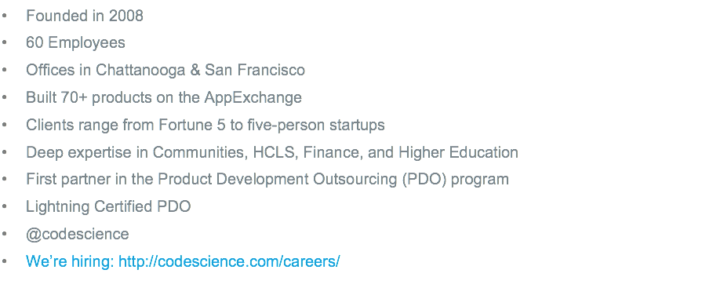
Notes:
1 minute
Talk about CodeScience for 30 seconds to a minute

Slide 7
The Problem
Modern JavaScript development with Salesforce can be painful
Notes:
2 minutes

Slide 8
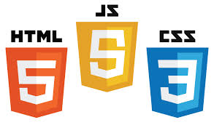






+
+
+
?
=
Notes:
2:15 Minutes
Take a Poll…. ? I don’t know… Who here has experienced pain developing JavaScript apps with Salesforce?
So at work, the guy to my left uses Linux.
The guy to my right uses Windows.
And the guy across from me uses OS X
And we all love the modern web
Since we love the modern web, naturally, we love Angular JS. But modern SPA development with Salesforce can be challenging, to say the least.
And with Angular 2 moving to Typescript, where does that leave us?
How can we continue to push the boundaries of the modern web, while working with Salesforce?
Web development used to be so simple. With all these new technologies coming out, I don’t know what to use.

Slide 9
Visual Studio Code
Introduced by Microsoft on April 30th at their //Build conference
Current Version: 0.8.0 (beta)
Notes:
4 minutes

Slide 10

Visual Studio Code
Offers a new choice of tool that combines the simplicity of a code editor with what we need as developers using a modern workflow
Notes:
4:30

Slide 11





Open Source Stack
Monaco*
OmniSharp
Roslyn
Notes:
5 minutes
1) Visual Studio Code stands on the shoulders of giants.
It’s built on Electron, the same foundation as Github’s new Atom editor
So Visual Studio Code is pretty much Atom under the covers.
So what does Microsoft bring to the mix? Why use Visual Studio Code over Atom?
2) Well, on top of the Electron Shell foundation, Microsoft adds their Monaco editor
3) And under that, Microsoft includes their Omnisharp/Roslyn project and the Typescript compiler. These tools combined give us Intellisense for JavaScript.
Imagine that, real Intellisense for JavaScript. You can get real method signatures for your JavaScript code
It’s built with open source. And because pretty much everything VSCode is built with is open source, and made with web technologies, the editor is hackable to the core. The editor is so meta, you can edit the editor with the editor.

Slide 12
Editor vs IDE
Notes:
7 minutes

Slide 13


lightweight / fast
lots of menus and buttons
file / folder
project files
many languages
code understanding & intellisense
many workflows
integrated build
keyboard centric
“file > new” / wizards
designers
lightweight / fast
play to debug
file / folder
with project context
platform tools
many languages
keyboard centric
task running & play to debug
Git integration
Intellisense
Notes:
7:15
0) Lets examine some of the features of an editor vs an IDE to give Visual Studio Code some better context.
Starting off, a Text editor is supposed to be lighweight and fast. Apps such as Notepad or Sublime Text are relatively small applications that open fast and attempt to get out of your way as much as possible. An editor has no idea of project structure and the only organization is done with folders. An editor can work with any language that is text, but provides nothing else.
On the other hand, an IDE, like Eclipse or Visual Studio Professional, has a lot of menus, buttons, and features. An IDE has project and solution files. An IDE inspects every bit of your code and provides intelligent code completion, refactoring suggestions, and method signatures. An IDE has an integrated build system, where you can do things like press F5 or click a “Play” button to start a project. An IDE has “File > New” wizards, code design surfaces, and code generation. It also has the ability to debug and provides platform specific tooling
And this is about where Visual Studio Code fits on the continuum. It’s small, coming in under 70mb on a Mac. It’s fast: typically launching in less than 3 seconds to a blinking cursor. And it has a keyboard centric design with an extensive list of customizable shortcuts. But it also has some features that typically belong to an IDE. It has a project settings folder for project level customizations, but the editor favors convention over configuration, so project files are not required. It has syntax highlighting 35+ languages and growing. It has a built in Task runner. It has incredible Git support baked in. It has a launch.json file which controls a Node.js debugger that can be started with a Play button! This editor has a really great Node.js debugger. But the biggest win, in my opinion, is VSCode has Intellisense for JavaScript! It’s a feature that really sets this editor apart from any other, real Javascript Intellisense, supported with TypeScript definition files that are as easy to install as right-clicking on a supported library in your code.

Slide 14
Salesforce and VSCode
Notes:
12 minutes

Slide 15
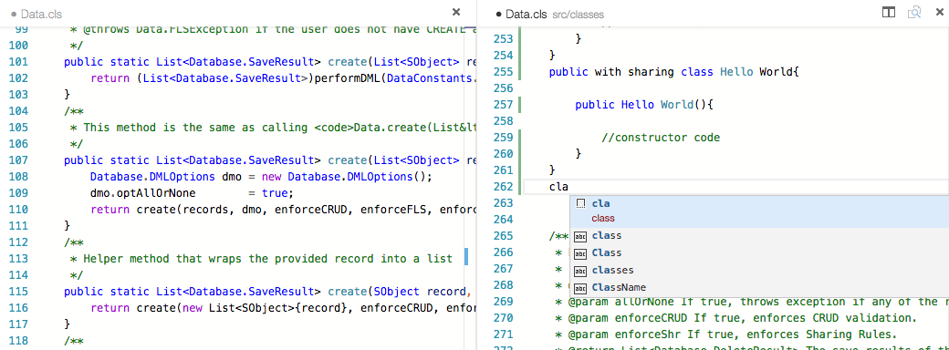
Using Visual Studio Code with Salesforce
Apex and Visualforce Syntaxes and Snippets
Snippets image goes here
Notes:
12:15
I mentioned earlier that VSCode has great language support for 35+ languages.
Well you can add Apex and Visualforce to the list.
With the magic of Open Source, we can import the appropriate Syntaxes and Snippets for Salesforce language support in Visual Studio Code.
Wow! So we can edit any Salesforce file in VSCode, with Colored Syntax highlighting, bracket matching, and indentation.
That’s cool. But what about that workflow we were supposed to be talking about?

Slide 16
The Modern Workflow
Notes:
14 minutes

Slide 17










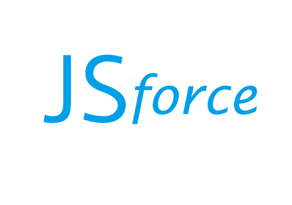

Integrate
Version
Code
Tasks
Retrieve
z
heroku/force
Generate
Install
Build
Deploy
Notes:
14:15
This Slide should take 8 minutes. Pace yourself.
0) Great! So we can edit Salesforce files in Visual Studio Code, but how do we go from ZERO
TO SALESFORCE
GENERATE. First, we need to start off with a good foundation. There’s a lot of boilerplate that goes into a project that can be automated. Whenever we start a new JavaScript app for someone, there are tools that give us a great starting point, with a project structure, settings files, and packages that follow best practices for your organization. Why type all that code again or make copypasta when there are tools that can do it for you in mere seconds.
INSTALL. We can then import some open source packages into our app with a package manager like NPM or Bower to properly utilize open source libraries like jQuery or Angular. The only part of this workflow that can’t be enhanced with VSCode is when we start a new component and realize we need to import a new library. Installing packages is easiest from the command line. So just press Shift+Cmd+C and a terminal window will appear with your current working directory.
BUILD. Now we need to build the code. We need to include, minify, uglify, optimize, and bundle our Front End Assets.
DEPLOY. Now that we have the code built, we need to push it up to Salesforce. So we use tools like Heroku Force and JSForce to deploy the code
CODE. Great, so this is the workflow, but where does Visual Studio Code fit into the mix? Why are we discussing it at all?
TASKS. another great feature of Visual Studio Code is it’s ability to run Tasks, specifically, use the tasks.json file which we use to wrap a Gulp File. VS Code also supports Gulp, Jake, and Grunt task runner files, natively, without using the tasks.json file, but tasks.json has special variables, like the current filename and path, and has “problem watcher” support so we can capture any errors from our build tools and get them right in the Editor window, with line highlighting and all!
RETRIEVE. But, we don’t work in a Silo.
VERSION. The build process is somewhat unique to each project, but Gulp and Webpack help us here. We can run build commands to lint, bundle, minify, and uglify our code. If we have a special command that launches a local server we can even use the launch.json file, which allows us to use the Play button and enables debugging for any Node.js application. We may also have “watch” tasks which watch our code for any changes and automatically runs. We can use watch tasks to auto-deploy our code
INTEGRATE. Use Continuous Integration with Circle CI and Cumulus CI scripts.
Cumulus CI Ant build files helps glue Git, CircleCI, ANT, and Salesforce together

Slide 18
Tying it all together with Tasks.json
Notes:
23 Minutes

Slide 19
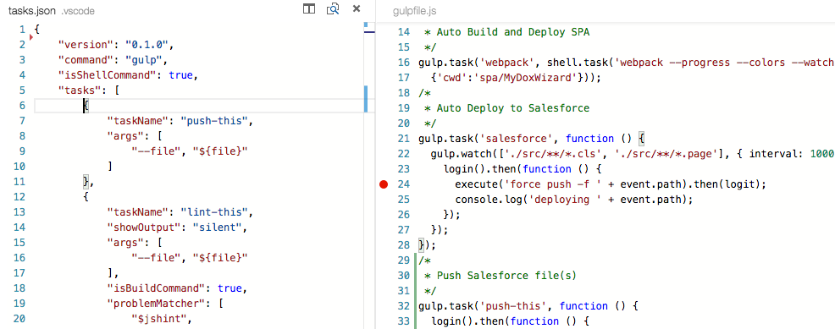
Tasks
Notes:
23:15 Minutes
(4 minutes)

Slide 20
The future for Visual Studio Code
Notes:
26 Minutes

Slide 21


The future is bright
Notes:
27:15 Minutes
I’m really excited about the future of Visual Studio Code.
Microsoft

Slide 22
Presentation Resources
Notes:
28 Minutes

Slide 23

Code you can use
*Plugin: Salesforce-VSCode
Hottowel Angular Typescript
https://github.com/CodeScience/Salesforce-VSCode
https://github.com/johnpapa/hottowel-angular-typescript
goo.gl/RNnZN6
goo.gl/WFV0zO
Slush-Angular-Webpack
JSR-Mocks
https://github.com/CodeScience/slush-angular-webpack
https://github.com/dshahin/jsr-mocks
goo.gl/F5PD7C
goo.gl/nMVuis
Notes:
29:15 Minutes

Slide 24


Notes:
29 minutes

